Slide 1
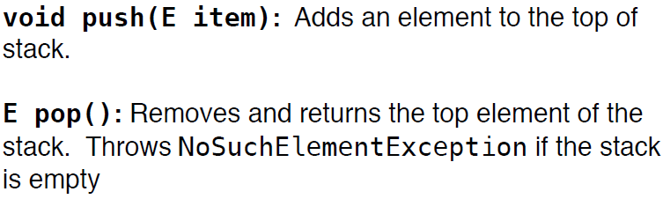
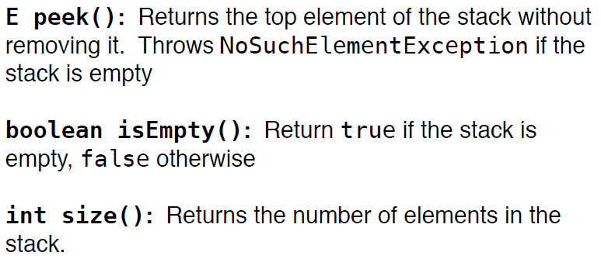
Stack: Access-Restricted List
No iterator is needed!

Slide 2
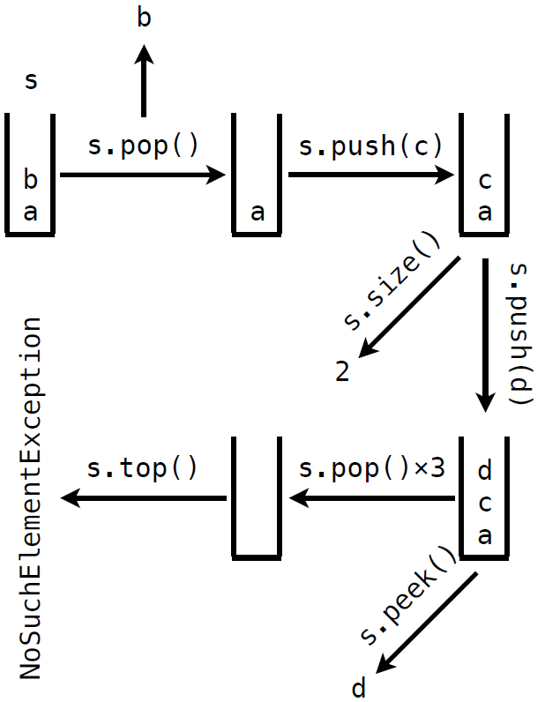

Slide 3
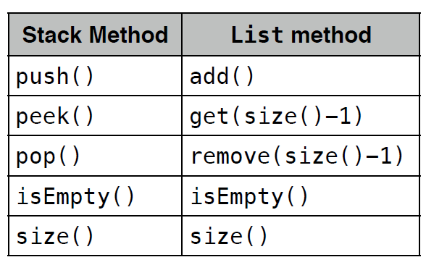
Java Implementations
You can implement a stack using a Java List
However, this comes with unnecessary features (and thus at the expense of efficiency)

Slide 4
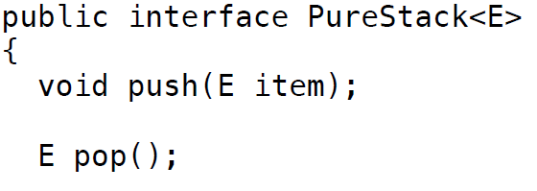
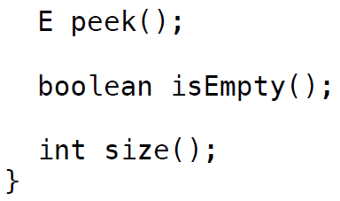
Light-weighted Implementations

Slide 5
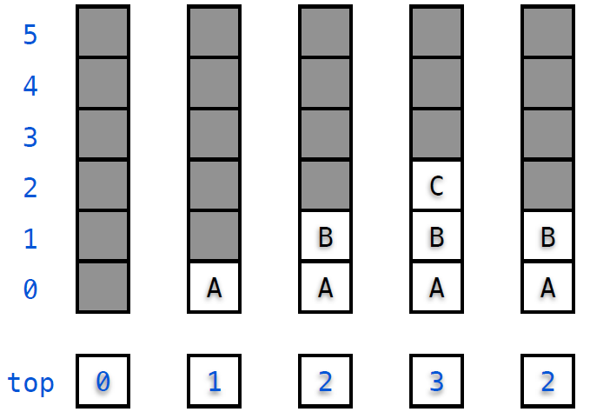
Array Implementation

Slide 6
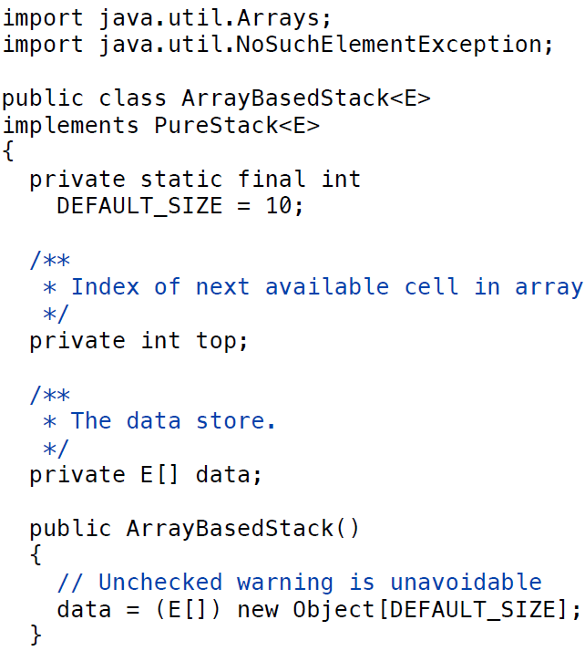

Slide 7


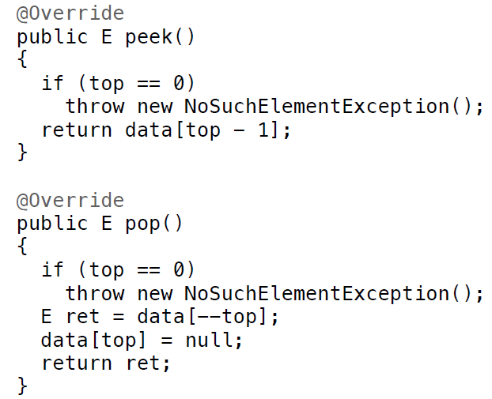

Slide 8
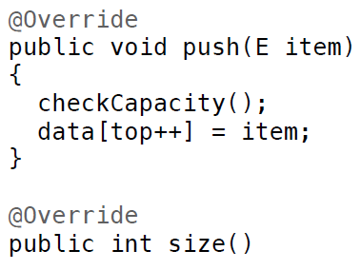

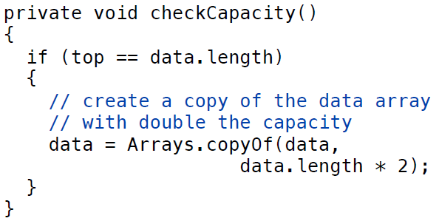

Slide 9
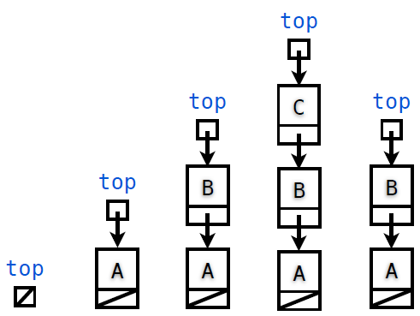
Linked-List Implementation

Slide 10
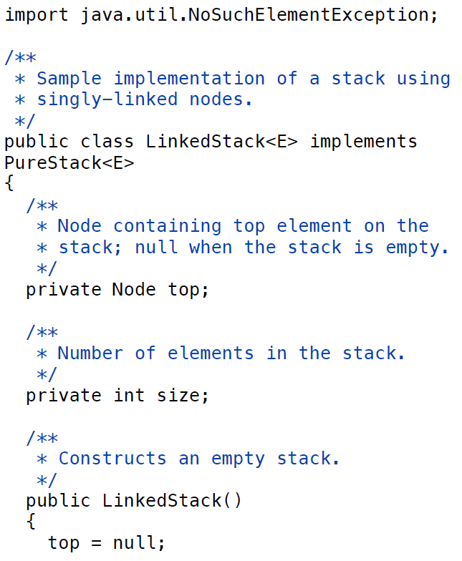


Slide 11
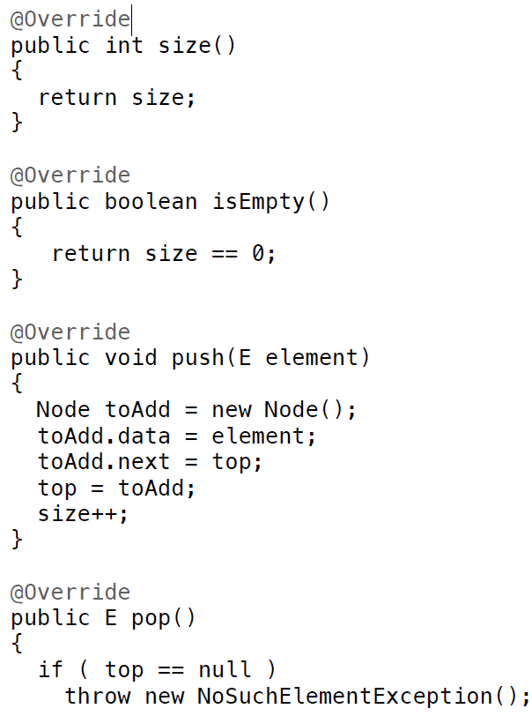
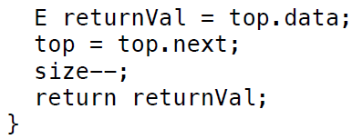

Slide 12
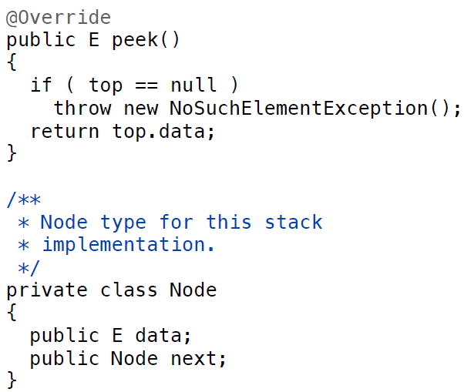

Slide 13
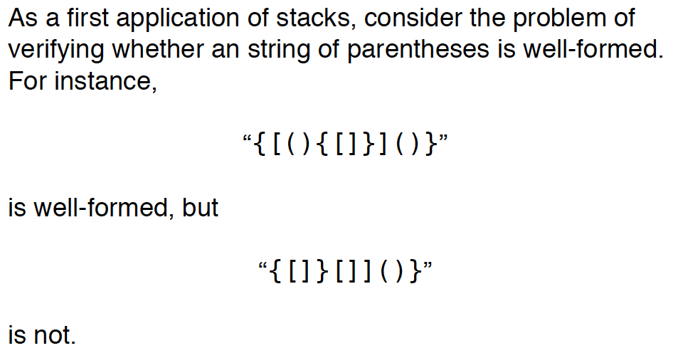
Application of Stack: Verifying Matched Parentheses

Slide 14
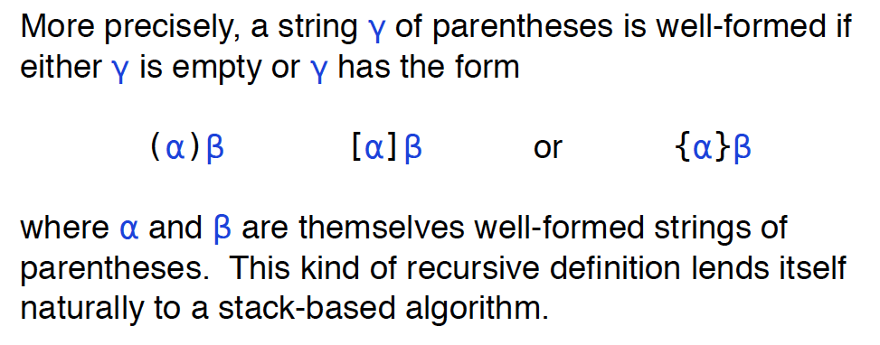
Application of Stack: Verifying Matched Parentheses

Slide 15
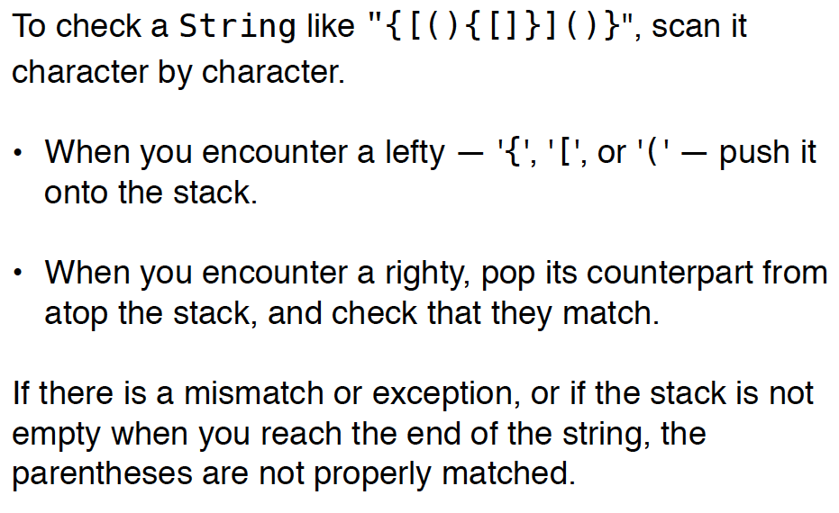
Application of Stack: Verifying Matched Parentheses

Slide 16
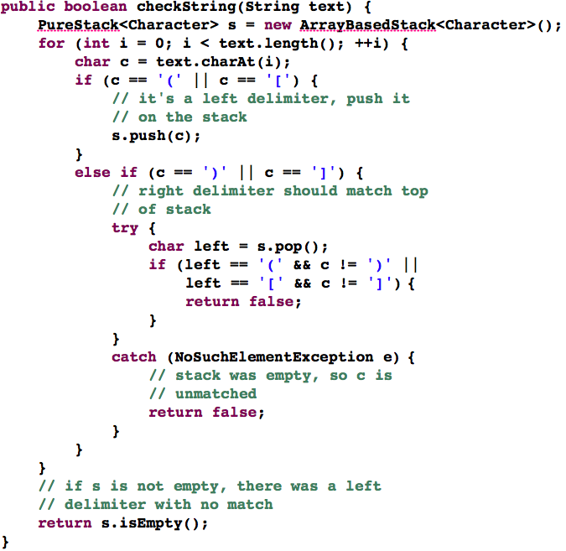

Slide 17
Application of Stack: Arithmetic Expression Evaluation
Infix Notation
Each binary operator is placed between its operands
Each unary operator precedes its operand
Postfix Notation
Also called Reverse Polish Notation (RPN) in which operands come before operators
-2 + 3 * 5 <--> (-2) + (3 * 5)
a b * c + <--> a * b + c

Slide 18
Infix and postfix are equivalent
Ex.
infix
postfix
a*b*c*d*e*f
ab*c*d*e*f*
1 + (-5) / (6 * (7+8))
1 5 - 6 7 8 + * / +
unary
(x/y – a*b) * ((b+x) – y^y )
x y / a b * – b x + y y ^ – *
(x*y*z – x^2 / (y*2 – z^3) + 1/z) * (x – y)
xy*z*x2^y2*z3^ – / – 1z/+xy – *

Slide 19
Advantages of Postfix
No need for parentheses
Easier to parse by computer than infix notation
Easy to implement using a stack (value on top of the stack)
Fast to evaluate

Slide 20
The postfixExpression Class
Take a postfix expression contained in a string and evaluates it
  Operands: single-digit nonnegative integers (for simplicity)
  Operators: +, -, *, /, %, ^

Slide 21
Postfix Evaluation
Use an operand stack (to store, say, integer operands)
  Start with an empty stack
  Scan the postfix expression from left to right
  Whenever you reach an number, push it onto the stack
  Whenever you reach an operator, OP, do the following:
    Pop two items right and left off the stack
    Evaluate (left OP right)
    Push the value back to the stack
  When you reach the end of the expression, pop the single remaining item from the stack (this is the value of the expression)

Slide 22
Example
Infix expression: (7 – 11) * 2 + 3
Postfix equivalent: 7 11 – 2 * 3 +
2
step 1
7
11 – 2 * 3 +
step 4
* 3 +
-4
11
– 2 * 3 +
step 2
step 5
-8
3 +
7
3
+
-4
2 * 3 +
step 6
step 3
-8
step 7
-5
The result!

Slide 23
Possible Error 1: Too many operands
During the evaluation, you can also check the correctness
of a postfix expression.
An error of the first type occurs when more than one
operand is left on the stack at the end of the scan.
2 3 + 4 6 –
3
2
3 + 4 6 –
+ 4 6 –
5
4 6 –
2
6
-2
4
4
–
6 –
5
5
5

Slide 24
Possible Error 2: Too many operators
The second type of error occurs when less than two
operands are left on the stack on scanning an operator.
2 3 + –
3
2
3 + –
+ –
5
–
2

Slide 25


Infix expression evaluation
Evaluating infix expression is non-trivial
Operators have different precedence
() > ^ > * = % = / > + = 1
Some operators are left associative: +, -, /, %
One operator is right associative ^

Slide 26
Infix to Postfix Conversion
Let’s first consider a simpler case
All the operators are left associative
No parentheses
Our algorithm uses a operator stack, opStack, to
temporarily store operators awaiting their right-hand-side operator
help manage the order of precedence

Slide 27
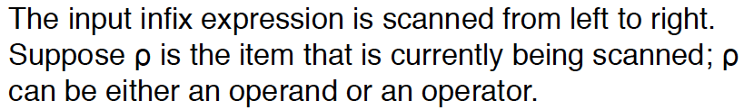

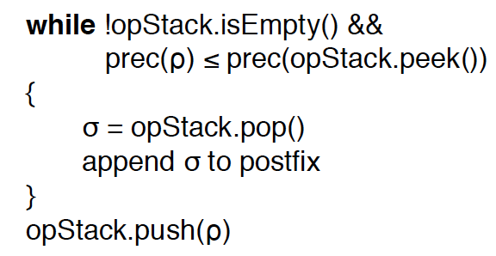

Our algorithm

Slide 28
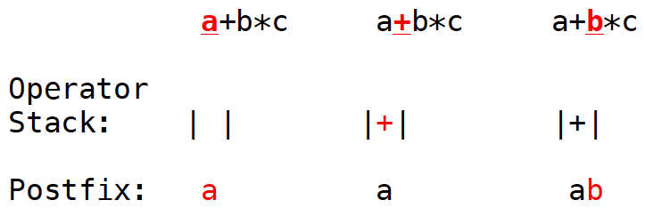
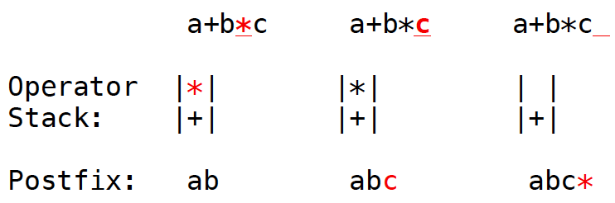
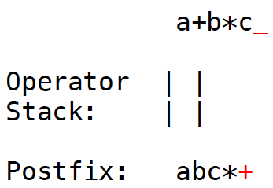
Example

Slide 29
Example1

Slide 30
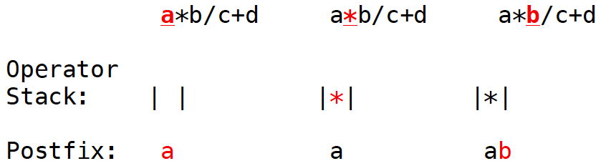
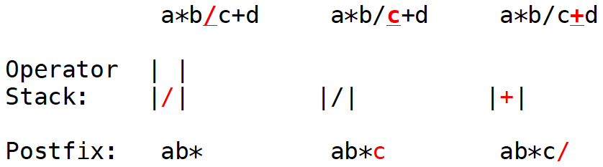
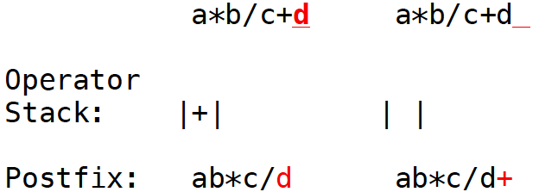
Example2

Slide 31
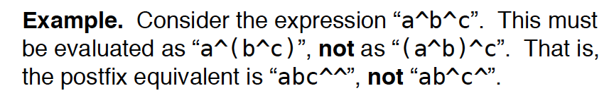
Infix to Postfix Conversion (General Case)
General case
handling right associative
handling parenthesis
Our algorithm
Each operator has two, possibly different, precedences, depending on whether it is being scanned as part of the input infix expression or it is already on the stack.

Slide 32
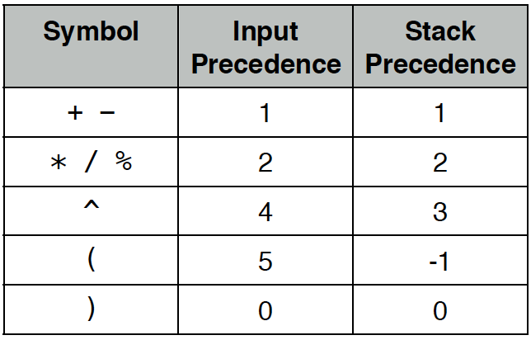

Slide 34
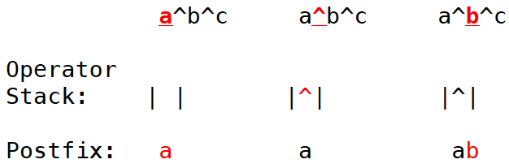
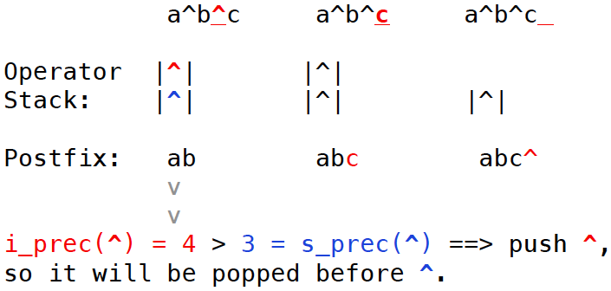
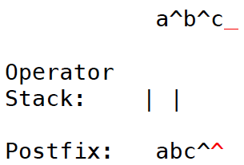

Slide 35
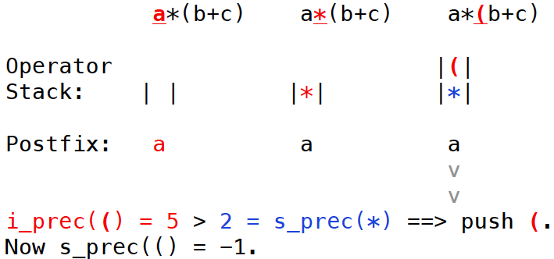
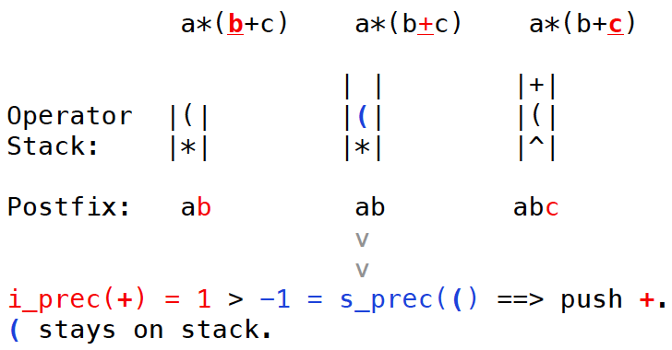

Slide 37
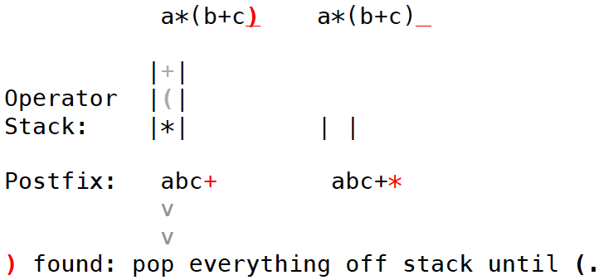

Slide 38
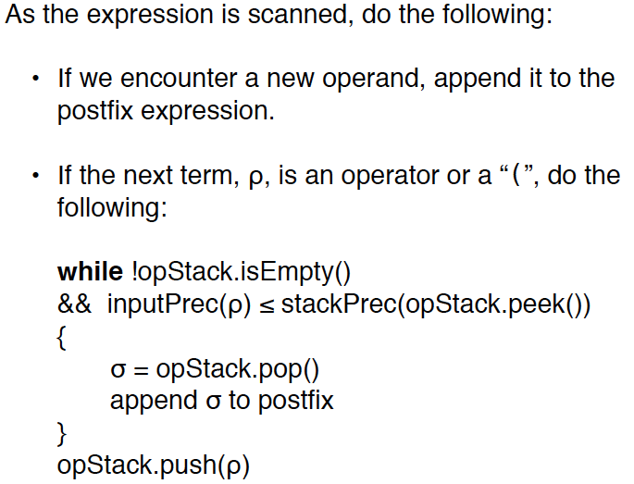
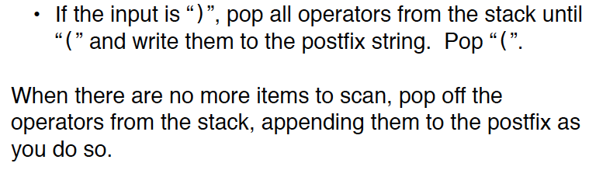
Algorithm

Slide 39
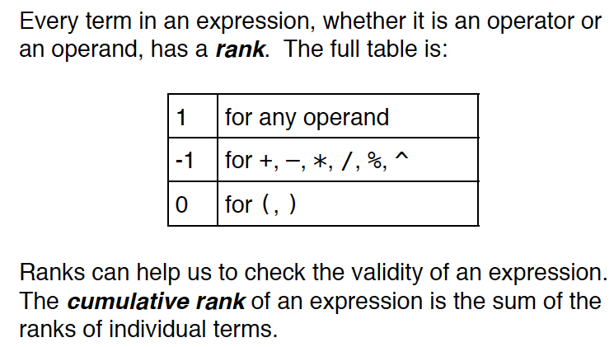
Error Checking

Slide 40
